Slide 1
IMAGE DEGRADATION MODELS AND NOISE MODELS
MODULE 4

Slide 2
IMAGE DEGRADATION AND RESTORATION MODEL
DEGRADATION
Deterioration of image quality due to factors like noise, blur, compression artifacts, and environmental distortions.
RESTORATION
Recovering the original image by applying computational techniques to reduce noise, sharpen details, and improve overall clarity.

Slide 3
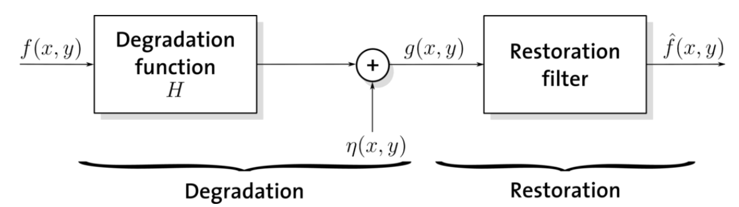

IMAGE DEGRADATION AND RESTORATION MODEL

Slide 4
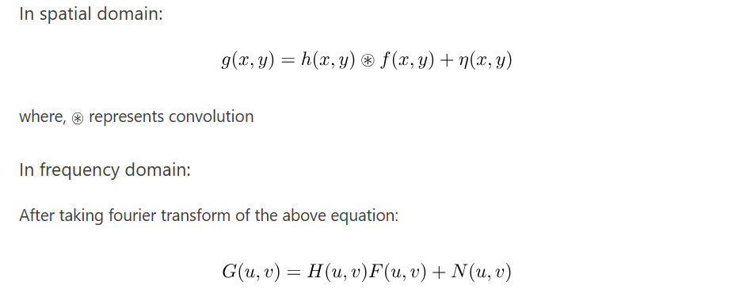
IMAGE DEGRADATION MODEL

Slide 5
NOISE MODELS
Principal source of noise arises during
Image acquisition
Environmental factors
Quality of sensing elements
Image transmission
Non-ideal channel characteristics
Interference in transmission channels

Slide 6
NOISE MODELS
Spatial Properties of Noise:
Randomness:
Random variations in pixel brightness.
Spatial Correlation:
Neighboring pixels share similar noise, forming patterns (e.g., stripes, bands).
Clustering:
Noise tends to group in specific image regions.
Impulsiveness:
Isolated bright or dark pixels (e.g., salt-and-pepper noise).

Slide 7
NOISE MODELS
Frequency Properties of Noise:
High-Frequency Noise:
Noise that has a significant amount of energy in high-frequency components appears as fine-grained or granular noise.
Low-Frequency Noise:
Noise that exhibits energy in low-frequency components appears as large scale variations or patterns.
Color Noise:
In color images, noise can exhibit different frequency properties in different color channels

Slide 8
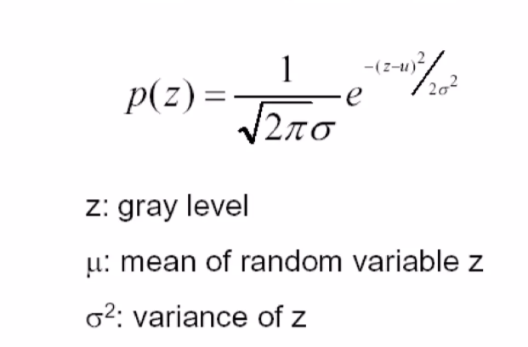
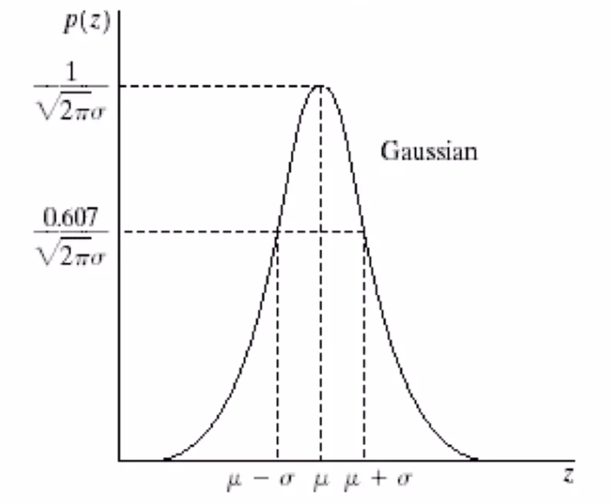
NOISE MODELS
Gaussian(Normal) noise
Gaussian noise arises in an image due to factors such as electronic circuit noise and sensor noise due to poor illumination or high temperature.
PDF of a random variable z,

Slide 9
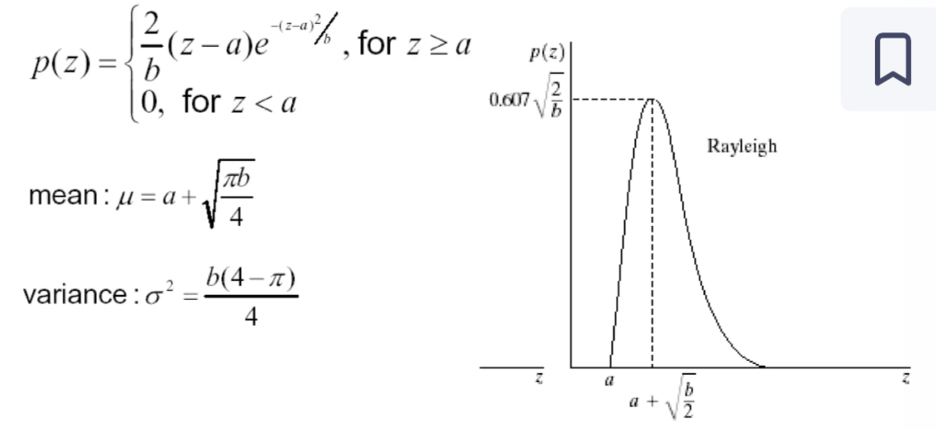
NOISE MODELS
2. Rayleigh noise
Rayleigh noise is a type of multiplicative noise that follows the Rayleigh distribution.
It commonly appears in imaging systems like ultrasound, radar, and synthetic aperture radar (SAR) due to the scattering effects of the medium.

Slide 10
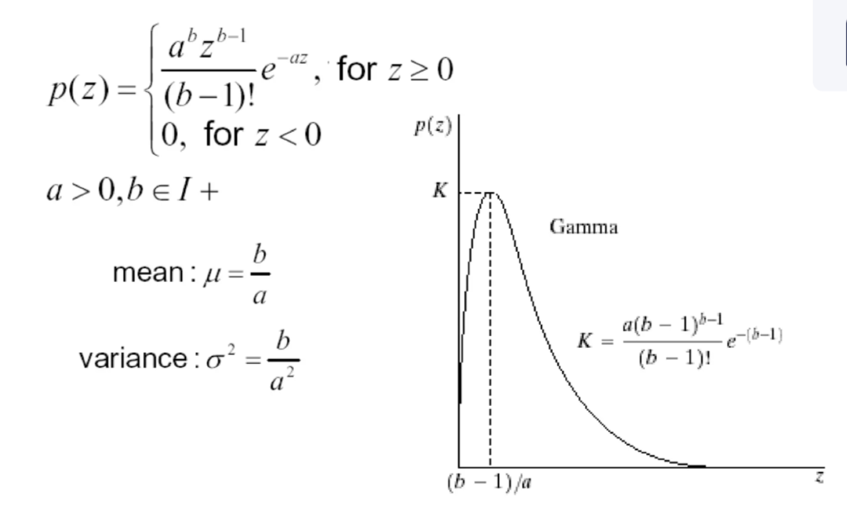
3. Erlang (gamma) noise
Erlang noise, also known as Gamma noise, follows the Gamma distribution and is commonly found in medical imaging (CT scans, MRI), radar, and fluorescence microscopy. z
It is often used to model multiplicative noise in imaging systems, particularly in low-light conditions.

Slide 11
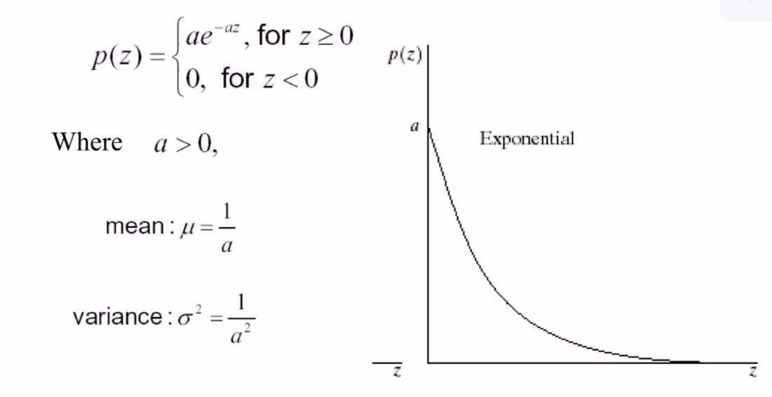
NOISE MODELS
4. Exponential noise

Slide 12
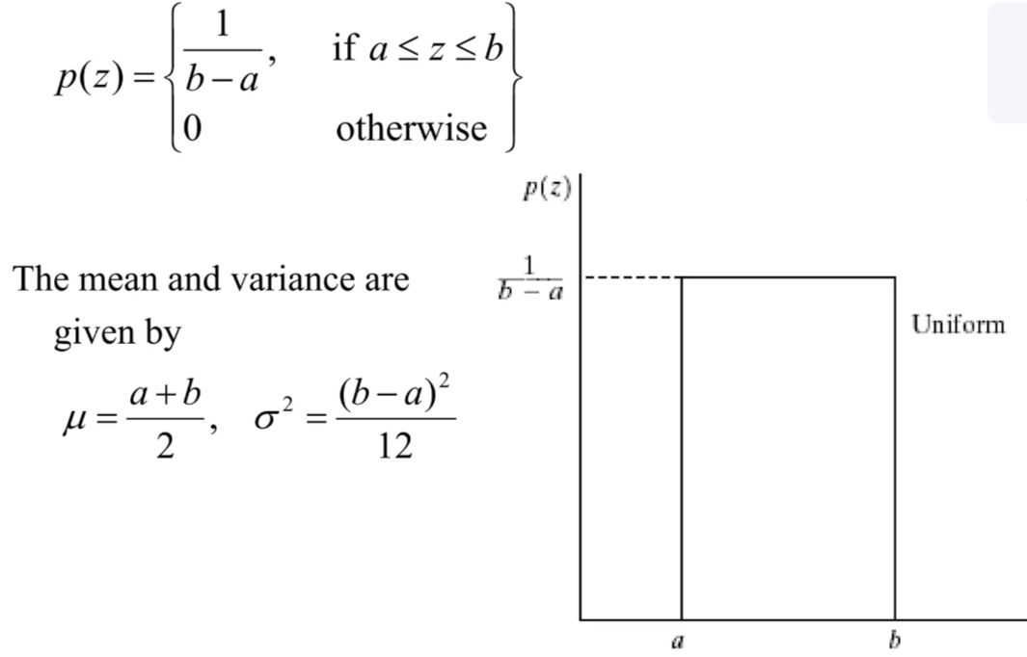
NOISE MODELS
5. Uniform noise
z

Slide 13
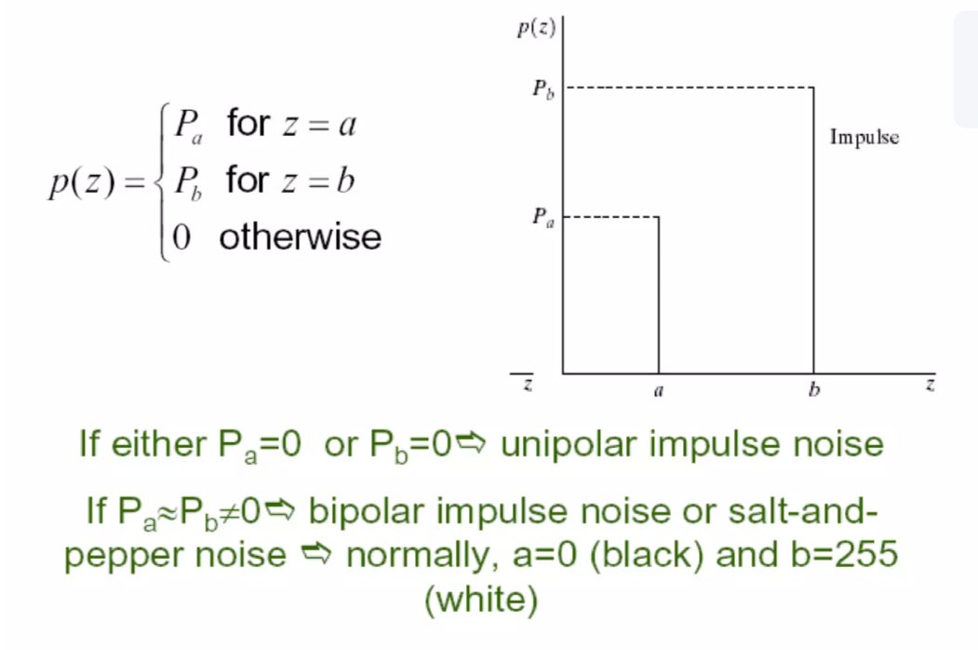
NOISE MODELS
6. Impulse (salt-and-pepper) noise

Slide 14
NOISE MODELS
7. Periodic noise
Periodic noise in an image arises typically from electrical or electromechanical interference during image acquisition
Periodic noise can be reduced significantly via frequency domain filtering.

Slide 15
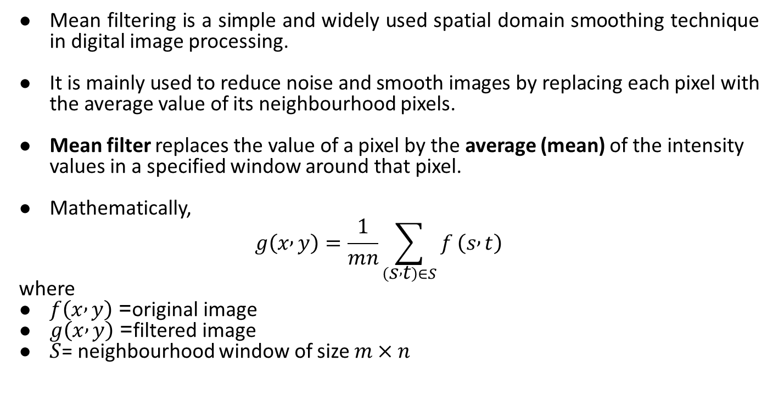
MEAN FILTERS
Mean filtering is a simple and widely used spatial domain smoothing technique in digital image processing.
It is mainly used to reduce noise and smooth images by replacing each pixel with the average value of its neighbourhood pixels.
Mean filter replaces the value of a pixel by the average (mean) of the intensity values in a specified window around that pixel.
Mathematically,
$$g\left(x , y\right)=\frac{1}{mn}\sum_{\left(s , t\right)∈S}{f}\left(s , t\right)$$
where
$f\left(x , y\right)$= original image
$g\left(x , y\right)$= filtered image
$S$= neighbourhood window of size $m×n$

Slide 16
CLASSIFICATION
Arithmetic Mean filter
2. Geometric mean filter
3. Harmonic mean filter
4. Contraharmonic mean filter

Slide 17
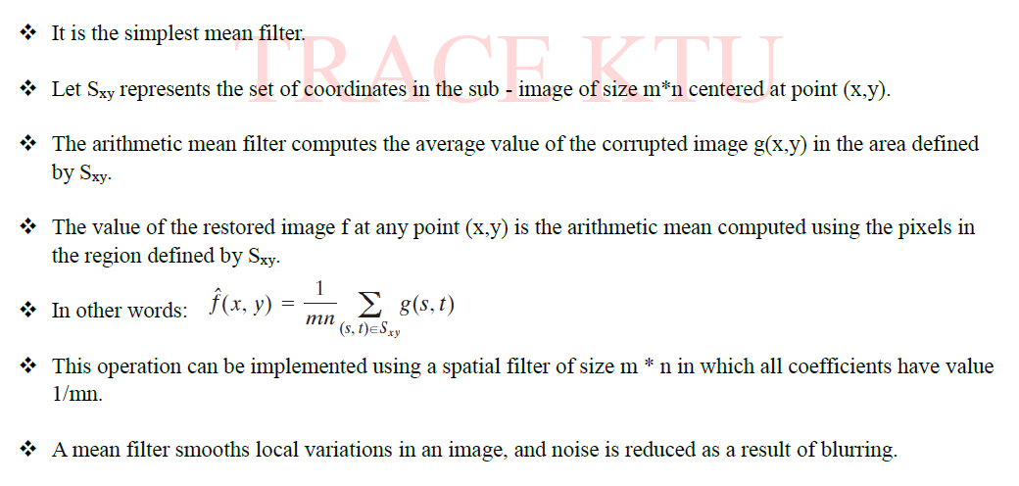
1. Arithmetic Mean Filter

Slide 18
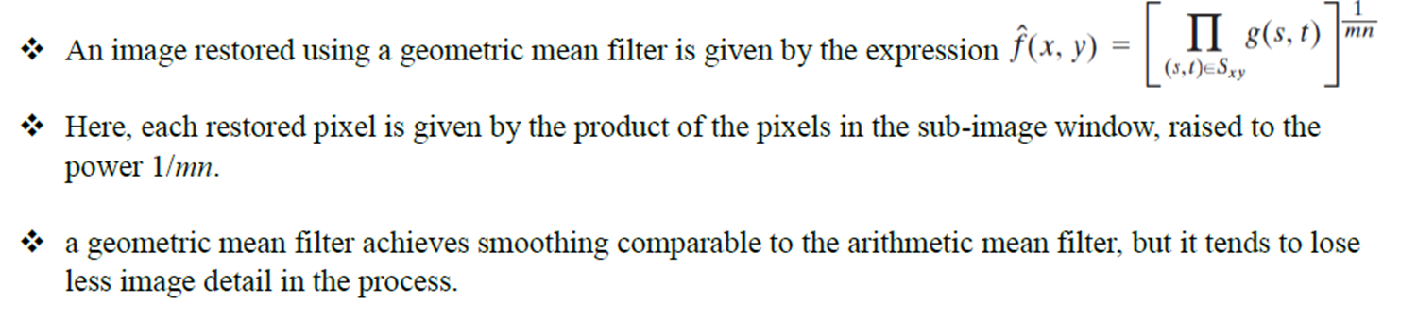
2. Geometric mean filter

Slide 19
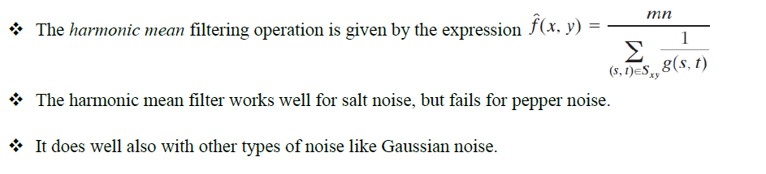
3.Harmonic mean filter

Slide 20
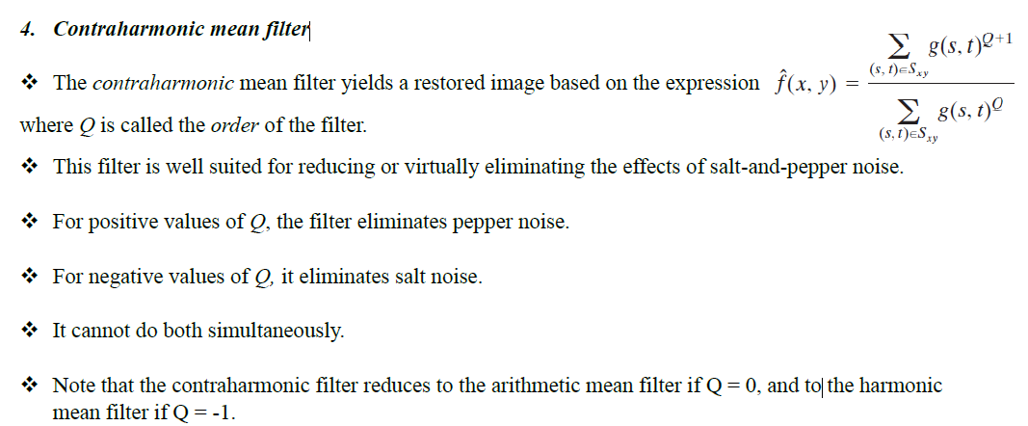

Slide 21
ORDER STATISTIC FILTERS
Order-statistic filters are nonlinear spatial filters whose response is based on ordering (ranking) the pixels contained in the image area encompassed by the filter, and then replacing the value of the center pixel with the value determined by the ranking result.

Slide 22
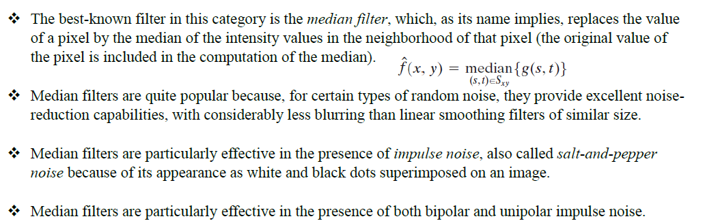
1. Median Filters

Slide 23
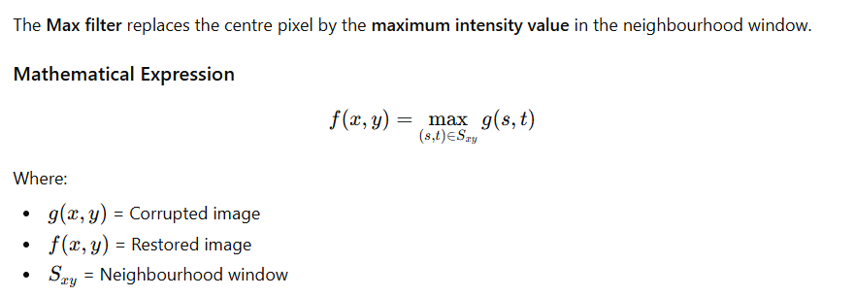
2. Max and min filters

Slide 24
Working Steps
Select window (e.g., 3×3).
Arrange pixel values inside window.
Choose the largest value.
Replace centre pixel with that value.

Slide 25
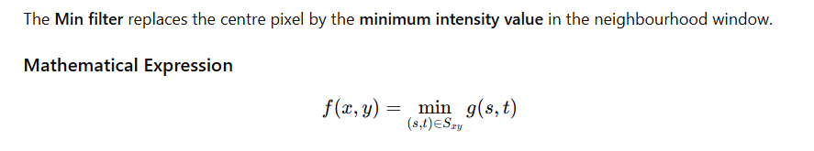
Min Filter
Working Steps
Select window (e.g., 3×3).
Arrange pixel values inside window.
Choose the smallest value.
Replace centre pixel with that value.

Slide 26

3.Midpoint Filter
The midpoint filter replaces the value of a pixel by the average of the maximum and minimum intensity values in its neighbourhood window.

Slide 27
4. Alpha Trimmed Filter:

Slide 28
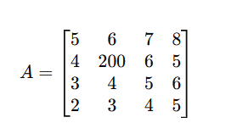
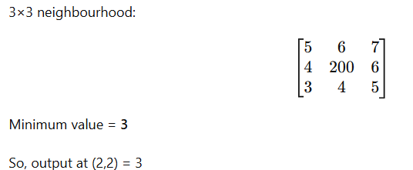
Given A 4 x 4 noisy image.Filter the Image using 3x3 MIN and MAX filter masks.
3 × 3 MIN Filter
The MIN filter replaces the center pixel by the minimum value in the 3×3 neighbourhood.

Slide 29
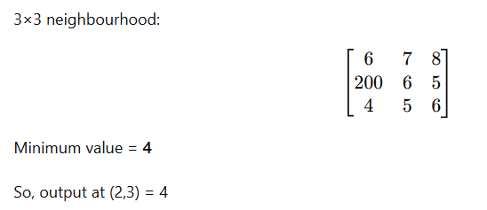
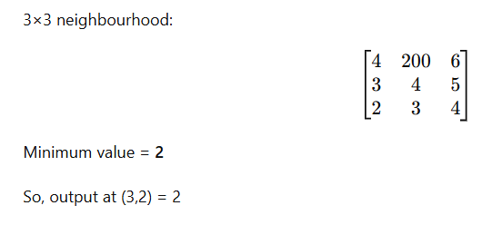
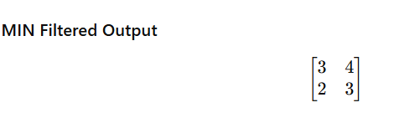
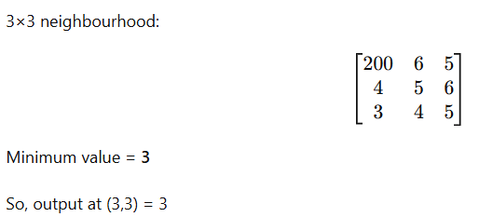

Slide 30
ADAPTIVE FILTERS

Slide 31
ADAPTIVE FILTERS
An adaptive filter is a filter whose behavior changes automatically based on the local characteristics of the image.
Unlike fixed filters, it adapts to different regions to remove noise while preserving important details like edges.
An adaptive filter adjusts its parameters depending on:
Local mean
Local variance
Noise level in the image
So, it performs different filtering in smooth and edge regions.

Slide 32
Types of Adaptive Filters
Adaptive Mean Filter
Adaptive Median Filter
Wiener Filter

Slide 33
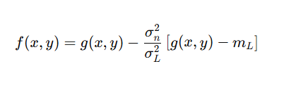
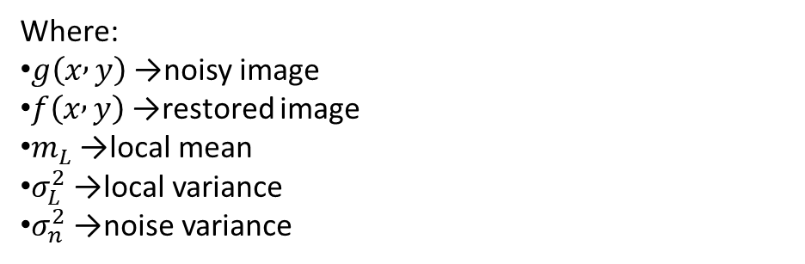
1. Adaptive, local noise reduction filter
An Adaptive Mean Filter is a statistical filter used to remove noise (especially Gaussian noise) while preserving edges better than a simple arithmetic mean filter.
Unlike a normal mean filter, it changes its behavior based on local image statistics (mean and variance).
Where:
$g\left(x , y\right)$→ noisy image
$f\left(x , y\right)$→ restored image
$m_{L}$→ local mean
$σ_{L}^{2}$→ local variance
$σ_{n}^{2}$→ noise variance

Slide 34
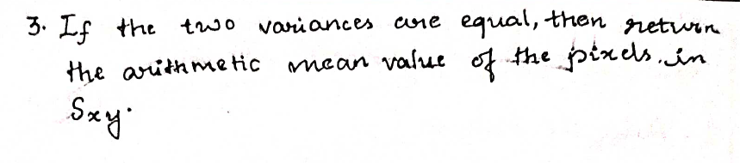

Slide 35
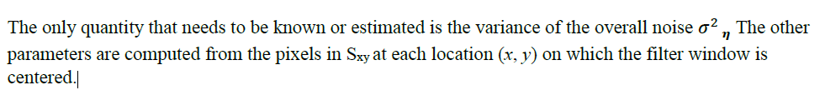

Slide 36
Adaptive Median Filter
Adaptive median filtering is an advanced nonlinear filter used mainly to remove impulse noise (salt-and-pepper noise) while preserving image details.
The median filter removes impulse noise, but it uses a fixed window size, which may:
Blur fine details
Fail when noise density is high
The adaptive median filter overcomes this by changing the window size automatically based on local noise.

Slide 37
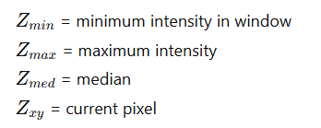
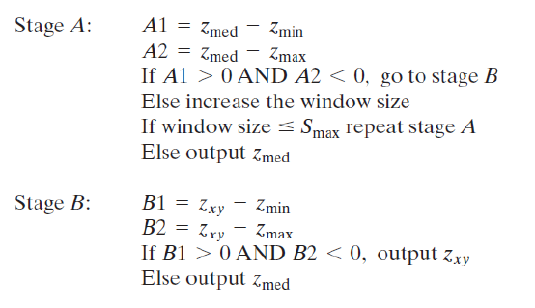
Algorithm
The adaptive median filter works in two stages:

Slide 38
Working Explanation
In smooth areas → Small window used In noisy areas → Window increases
In edges → Original pixel preserved
STEPS
Start with 3×3 window
Compute min, max, median
Check if median is valid
If not → increase window
If center pixel is noisy → replace with median
Continue for entire image

